Slide 1

Welcome
Logipool Infotech Pvt. Ltd

Slide 2
Statements
An instruction written in a high-level language. A statement directs the computer to perform a specified action.
A single statement in a high-level language can represent several machine-language instructions.

Slide 3
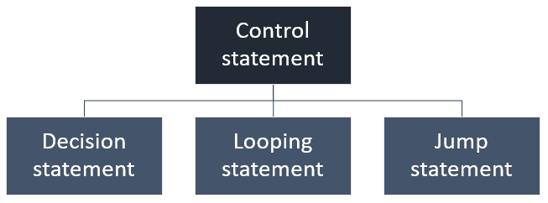

Slide 4
Control Stetment
Control statements are heart of any programming language.
In your programming life you will find 60-70% of your program consist control statements.
To master the art of programming, you must have a good control over your program.
You must have a solid grip over control statements.

Slide 5
Decision statement
Decision statement is condition based statement. It define single or set of conditions that must be satisfied before statement/s can execute.
Simple if statement
if...else and if...else...if statement
Nested if...else statement
Switch...case

Slide 6
Looping statement
Looping statement defines a set of repetitive statements . These statements are repeated, with same or different parameters for a number of times.
for loop
while loop
do...while loop

Slide 7
Jump statements
Unlike conditional and looping statement, jump statement provides unconditional way to transfer control from one part of program to other.
break
continue
goto

Slide 8
Simple if
if statement allows us to select an action based on some condition.
It gives programmer to take control over a piece of code.
Programmer can control the execution of code based on some condition or user input.
A C expression that evaluates either true or false is known as Boolean expression.
However, in C programming there is no concept of true or false value.

Slide 9
Syntax
if(boolean_expression)
{
// body of if
}

Slide 10
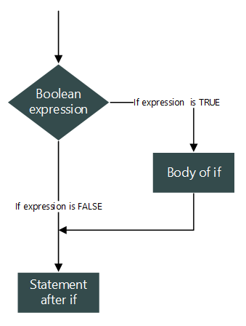

Slide 11
If…else and if…else…if statement in C
if...else Syntax
if...else Flowchart
if...else Example
Ladder if...else...if Syntax
Ladder if...else...if flowchart
Ladder if...else...if example

Slide 12
Syntax of if...else statement
if(boolean_expression)
{
// Body of if
// If expression is true then execute this
}
else
{
// Body of else
// If expression is false then execute this
}

Slide 13
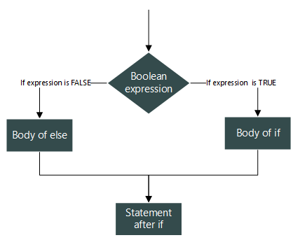
Flowchart of if...else statement

Slide 14
Ladder if...else...if statement
if (boolean_expression_1)
{
// If expression 1 is true then execute
// this and skip other if
}
else if (boolean_expression_2)
{
// If expression 1 is false and
// expression 2 is true then execute
// this and skip other if
}
else if (boolean_expression_n)
{
// If expression 1 is false,
// expression 2 is also false,
// expression n-1 is also false,
// and expression n is true then execute
// this and skip else.
}
else
{
// If no expressions are true then
// execute this skipping all other.
}

Slide 15
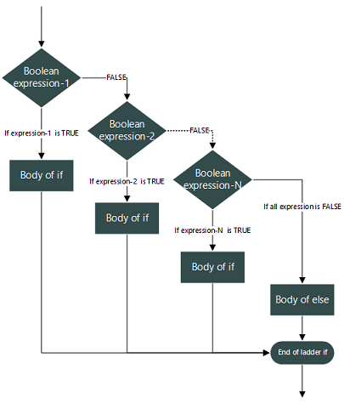

Slide 16
Nested if…else statement in C
if (boolean_expression_1) { if(nested_expression_1)
{
// If boolean_expression_1 and
// nested_expression_1 both are true }
else {
// If boolean_expression_1 is true
// but nested_expression_1 is false }
// If boolean_expression_1 is true
}
Else { if(nested_expression_2)
{
// If boolean_expression_1 is false
// but nested_expression_2 is true
}
else {
// If both boolean_expression_1 and
// nested_expression_2 is false
}
// If boolean_expression_1 is false
}

Slide 17
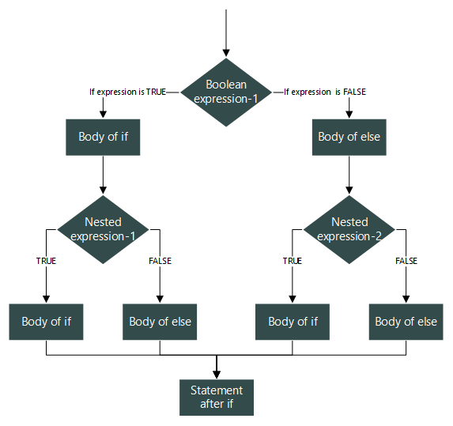

Slide 18
switch…case statement in C
switch(expression) {
case 1:
/* Statement/s */
break;
case 2:
/* Statement/s */
break;
case n:
/* Statement/s */
break;
default:
/* Statement/s */
}

Slide 19
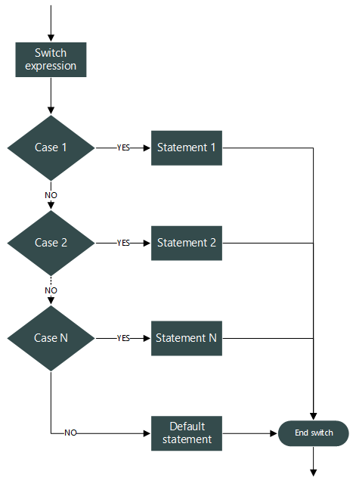

Slide 20
Nesting of switch...case statement
switch(expression)
{
case 1: /* Statement/s */
break;
case 2: /* Statement/s */
switch(inner_expression)
{ case 1: /* Statement/s */
break;
case 2: /* Statement/s */
break;
case n: /* Statement/s */
break;
default: /* Statement/s */
break;
}
break;
case n: /* Statement/s */
break;
default: /* Default statement/s */
}

Slide 21
While loop in C programming
while(condition)
{
// Body of while loop
}

Slide 22
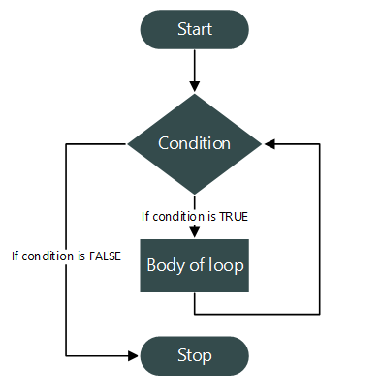
Flowchart of while loop

Slide 23
Do…while loop in C programming
do
{
// Body of do while loop
} while (condition);

Slide 24
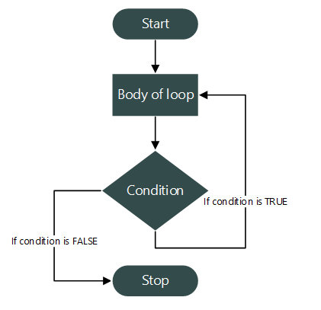

Slide 25
For loop in C programming
for(variable-initialization ; condition ; variable-update)
{
// Body of for loop
}

Slide 26
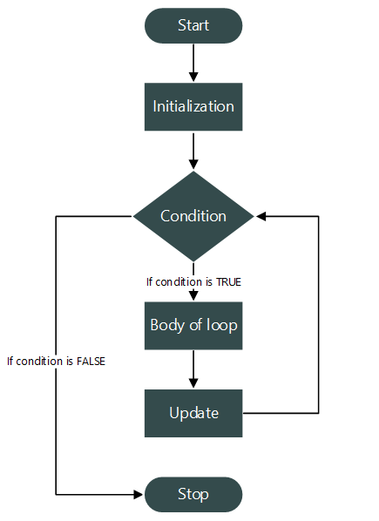

Slide 27
Nested loops in C programming
outer_loop
{
inner_loop
{
// Inner loop statement/s
}
// Outer loop statement/s
}

Slide 28
for(initialization; condition; update)
{
// statements
for(initialization; condition; update)
{
// Inner loop statements
}
// statements
}

Slide 29
break statement in C
Syntax:
break;
break is jump statement used to terminate a switch or loop on some desired condition.

Slide 30
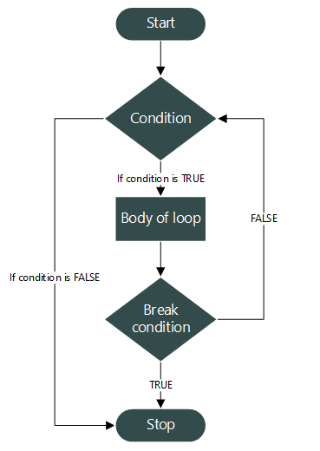

Slide 31
continue statement in C
Syntax:
continue;
continue is a jump statement used inside loop.

Slide 32
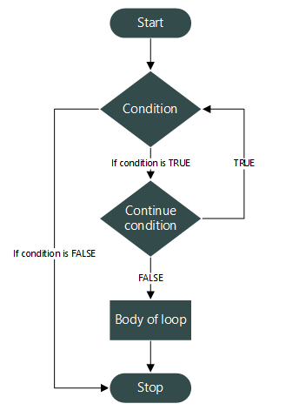

Slide 35
Thank You

